Slide 1
Welcome to PCT’s
Open House
G rowing our Business
September 19, 2013

Slide 2
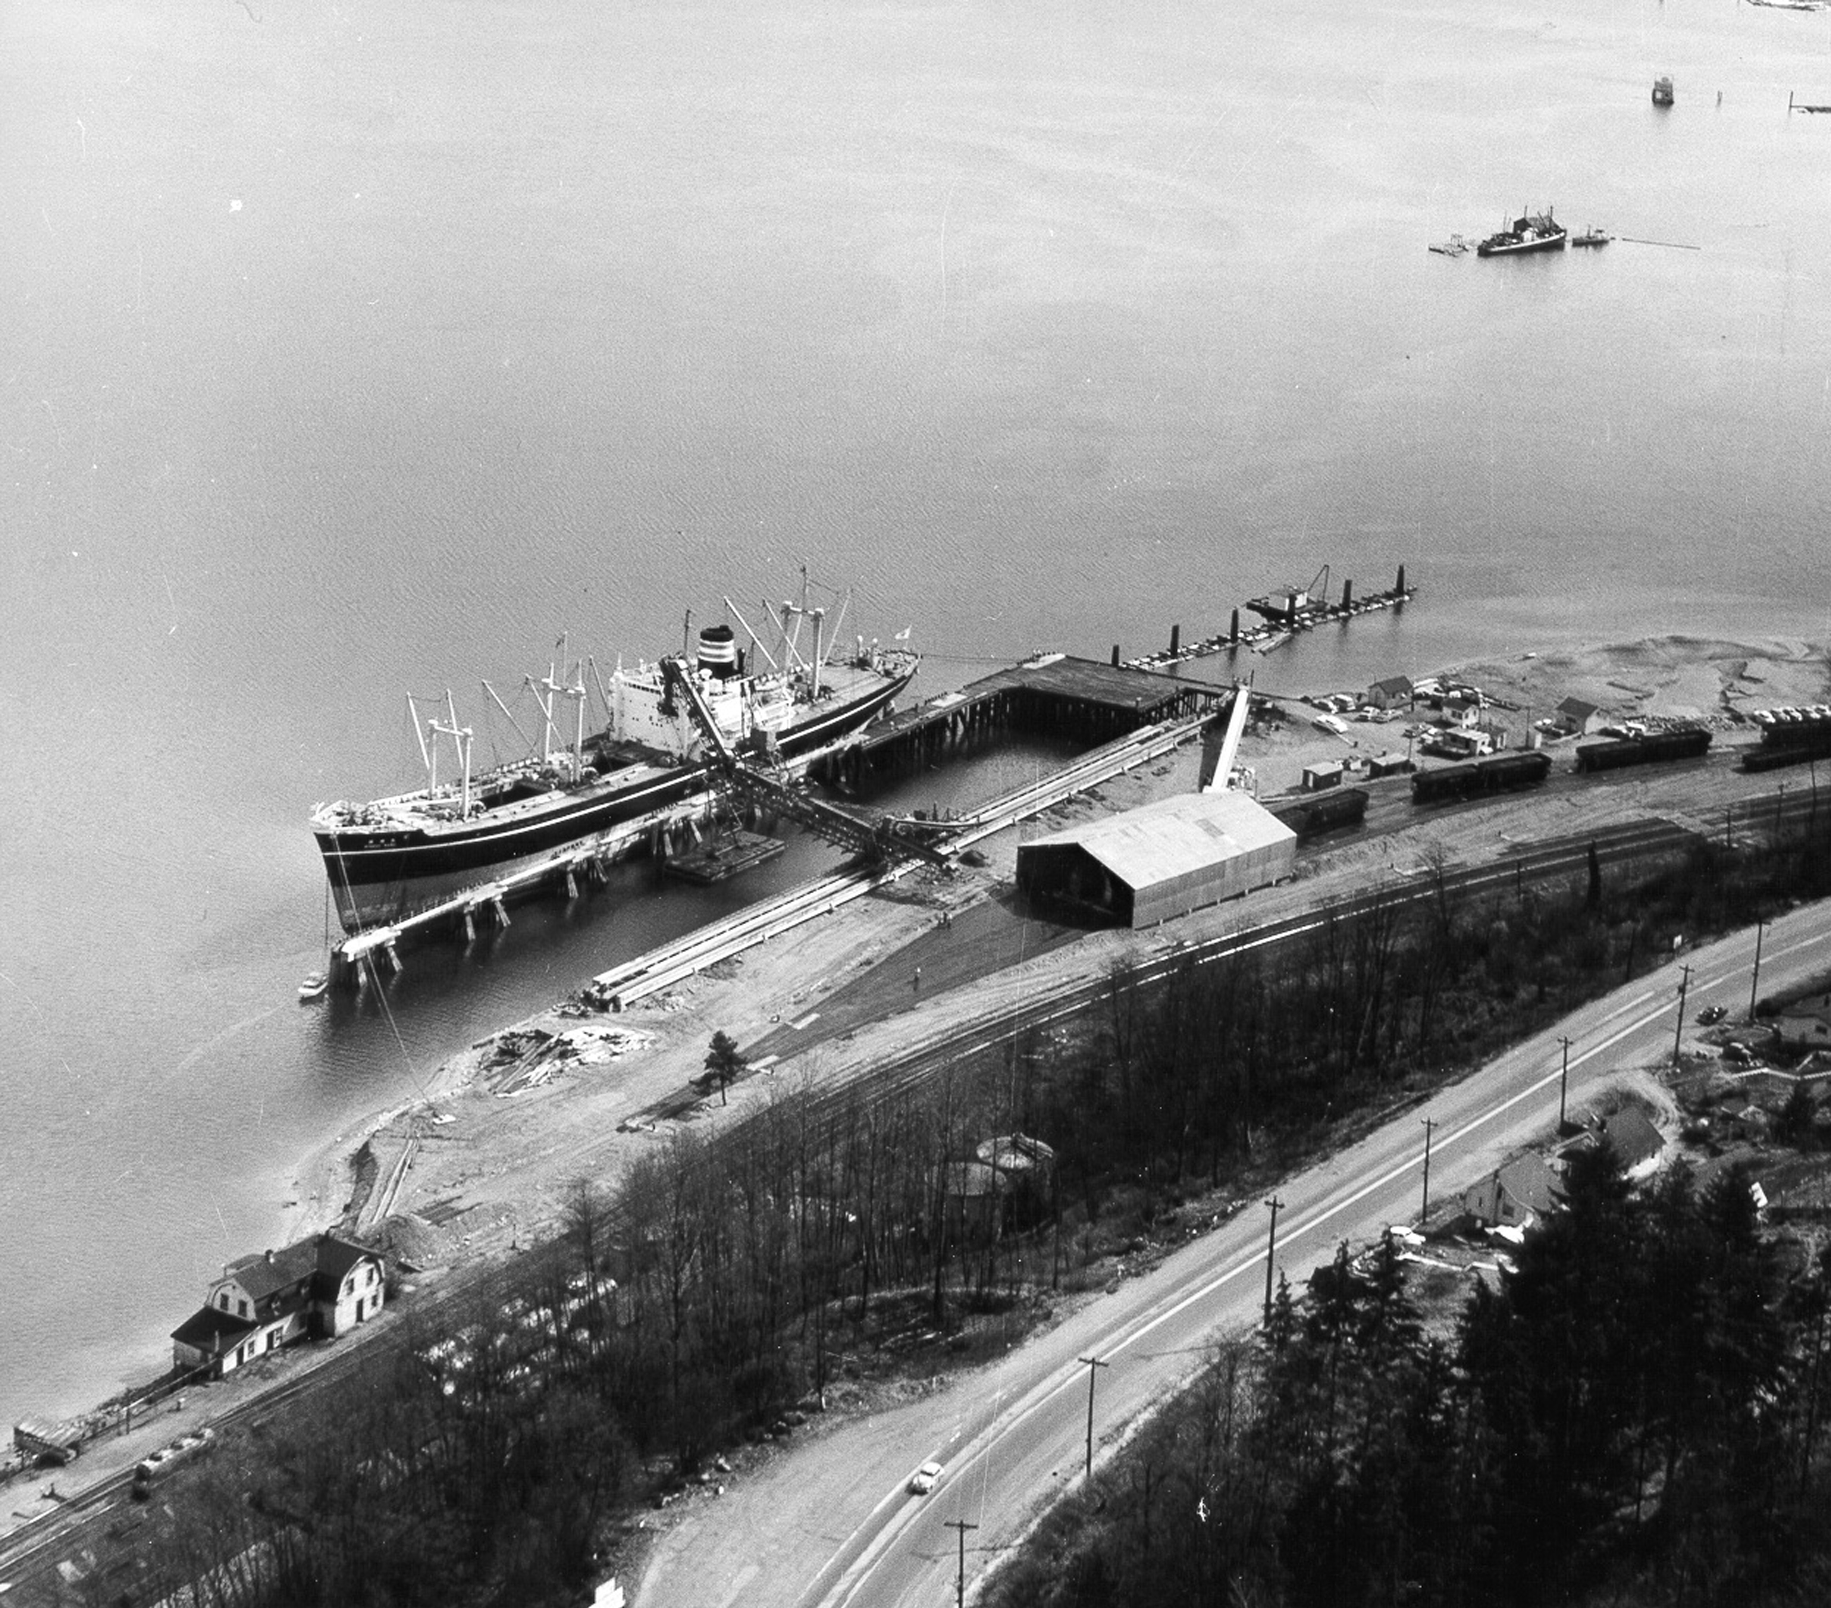
PCT in Port Moody
PCT originally started in 1929 in New Westminster and has operated in Port Moody since 1960
Major bulk export terminal in Port Metro Vancouver for over 53 years
Has handled a variety of products for Western Canadian shippers (sulphur, coal, glycol, styrene, potash, urea, phosrock, woodchips, grain, gypsum, etc.)
PCT’s First Shiploading 1960
The Port in Port Moody

Slide 3
PCT in Port Moody
PCT has become one of the most modern bulk terminals in the world
Won local and international awards for safety, environmental stewardship, and people development
Currently handle 1.6 million tonnes of sulphur and 700,000 tonnes of glycol per year (plus temporarily handling up to 500,000 tonnes of coal)
These volumes have decreased 50% from shipments 10 years ago
PCT has been exploring additional business opportunities to compliment existing products

Slide 4
Why PCT’s Business Development is Important to Port Moody
PCT is a critical outlet for Western Canada resource shippers – current exports contribute approx $1.5 billion to Canada’s economy
Major tax payer in Port Moody ($840,000 in 2013) - helps reduce residential taxes
Currently supports 70 full time jobs in Port Moody
Financially supports a variety of local charities and organizations:
  Crossroads Hospice - Sunday Summer Concerts
  PCT Curling Centre - SHARE Society Food Bank
  Port Moody Library - Port Moody Arts Centre Society
  Port Moody Ecological Society - Port Moody Firefighters
Port Moody Rotary Club - Port Moody Heritage Society
Rocky Point Performance Stage - Golden Spike Days
Without a financially sustainable PCT, all of these benefits would be in jeopardy.

Slide 5
Growing Our Business
  PCT has been exploring opportunities to handle two new products -
  Canola Oil
  We have concluded a agreement with Bunge Canada to handle their canola oil
  This Open House is to inform the community of our plans and to seek your comments and/or concerns so we can address them as we develop the project
  Potash
  We continue to have discussions with a potash shipper and are working on arrangements to handle their product at a future date
    Once an agreement is in place with the potash shipper PCT will conduct another Open House to provide you with as much information as possible and to give you an opportunity to provide input on the project

Slide 6
Growing Our Business
  In addition to introducing new products, PCT is improving site infrastructure and vessel access to the terminal –
  Waste Water Treatment
  PCT is replacing its current settling pond with a water clarifier to more efficiently handle its waste water
  Navigation Channel Dredging
  The navigation channel west of the terminal is too shallow to allow fully loaded vessels to sail during low tides. To eliminate this restriction the channel will be dredged deeper.
  Both of these projects will be described later in this presentation.

Slide 7
Canola Oil
Growing our Business
Canola oil comes from crushing the seeds of the canola plants that are grown throughout the Canadian prairies
Canada is the largest producer of canola oil in the world – contributes $15 billion to Canada’s economy
It is considered the healthiest of all commonly used cooking oils
Canola is a yellow flowering plant which produces the seed-filled pods that are rich in oil
Canola is named “Can” (for Canada) and “ola” (for oil, low acid)

Slide 8

Canola Oil
PCT will be handling canola oil on behalf of Bunge Canada
  Bunge is Canada’s largest oilseed processor and largest manufacturer of edible oil products
The canola oil shipped through PCT will be “Crude, Super Degummed Canola Oil” - requires one final refining step by receiver before packaging
Canola oil from Cargill’s crushing plants in Canada also will be shipped through PCT

Slide 9
Canola Oil handling
PCT has handled liquid ethylene glycol safely for 30 years and the expertise and on-site technology used for ethylene glycol also will be used for canola oil handling
While initially handling 400,000 tonnes of canola oil annually, PCT may eventually handle up to 750,000 tonnes of canola oil per year
Canola oil will be delivered by railcar; pumped to storage tanks; then loaded to vessels for transportation to world-wide markets, primarily in Asia

Slide 10
Benefits to the Community
Addition of approximately 15 new full time equivalent jobs at PCT, plus additional jobs for vessel operations (tugs, pilots, agents, ship chandlers) and rail operations
Approximately $390,000 in additional municipal taxes
Increased expenditures of local goods and services
Approximately 300 construction related jobs over a one-year period

Slide 11
  Canola Oil New Construction
  Modifications to existing glycol railcar unloading stations with a new pipeline to storage tanks
  3 new additional storage tanks to provide inventory for up to 45,000 tonnes of canola oil
  Canola oil shipping pipeline from storage tanks to berth
  New articulated marine loading arm at berth
  Small extension to west end of berth
  Total $35 million project infrastructure investment

Slide 12
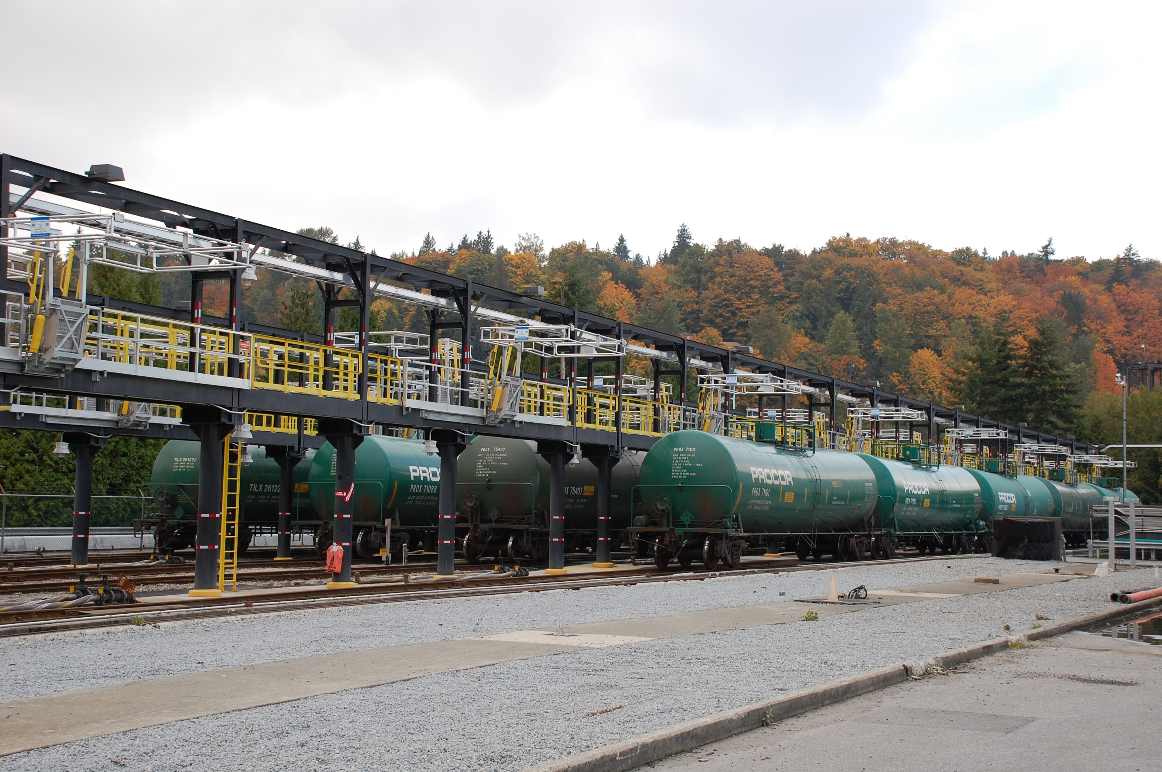
Railcar Unloading
Modifications to railcar rack to allow for the unloading of Canola as well as glycol
Continuous trays under all railcars to capture any drips
Railcar area surrounded by concrete dyke and clay liner

Slide 13
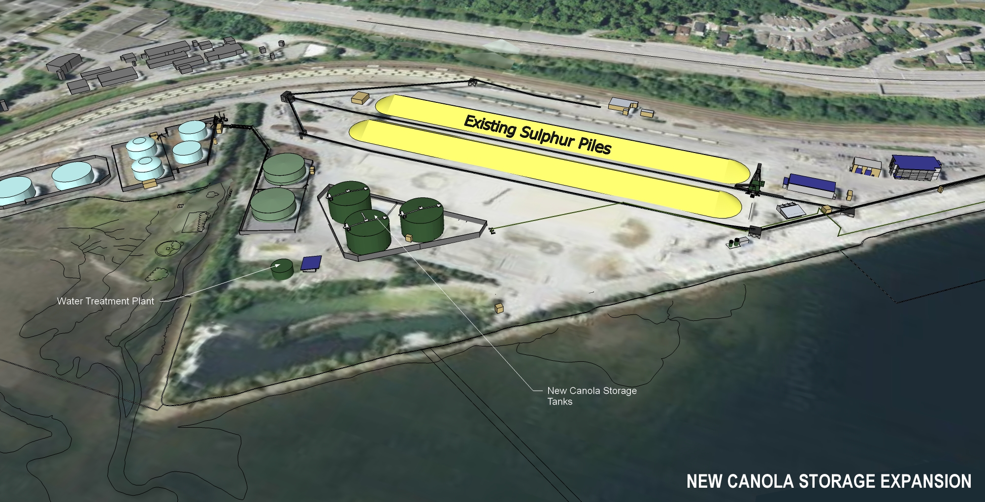
Storage Tanks
3 new 15,000 tonnes storage tanks for a total of 45,000 tonnes
Surrounded by concrete dyke and a liner to contain 110% of one tank
Automatic overfill protection on tanks and automatic isolation valves
New Canola Storage tanks

Slide 14
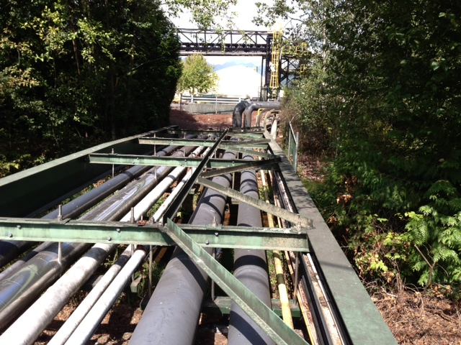
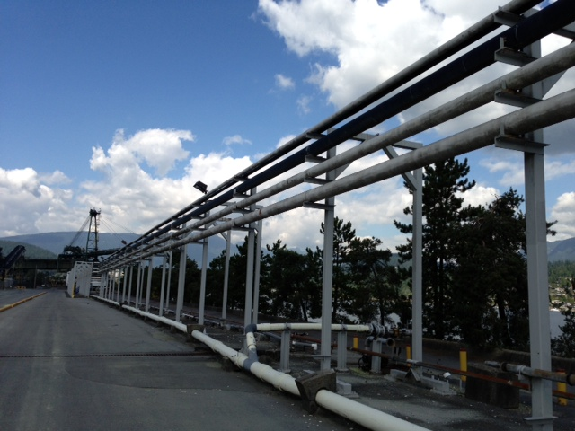
Pipelines
Pipeline over creek will be double walled with internal leak monitoring using existing pipe bridge – no impact to riparian zone
Piping over marine foreshore area will be in an enclosed and monitored containment tray system
All pipes will be above ground to allow visual monitoring and access

Slide 15
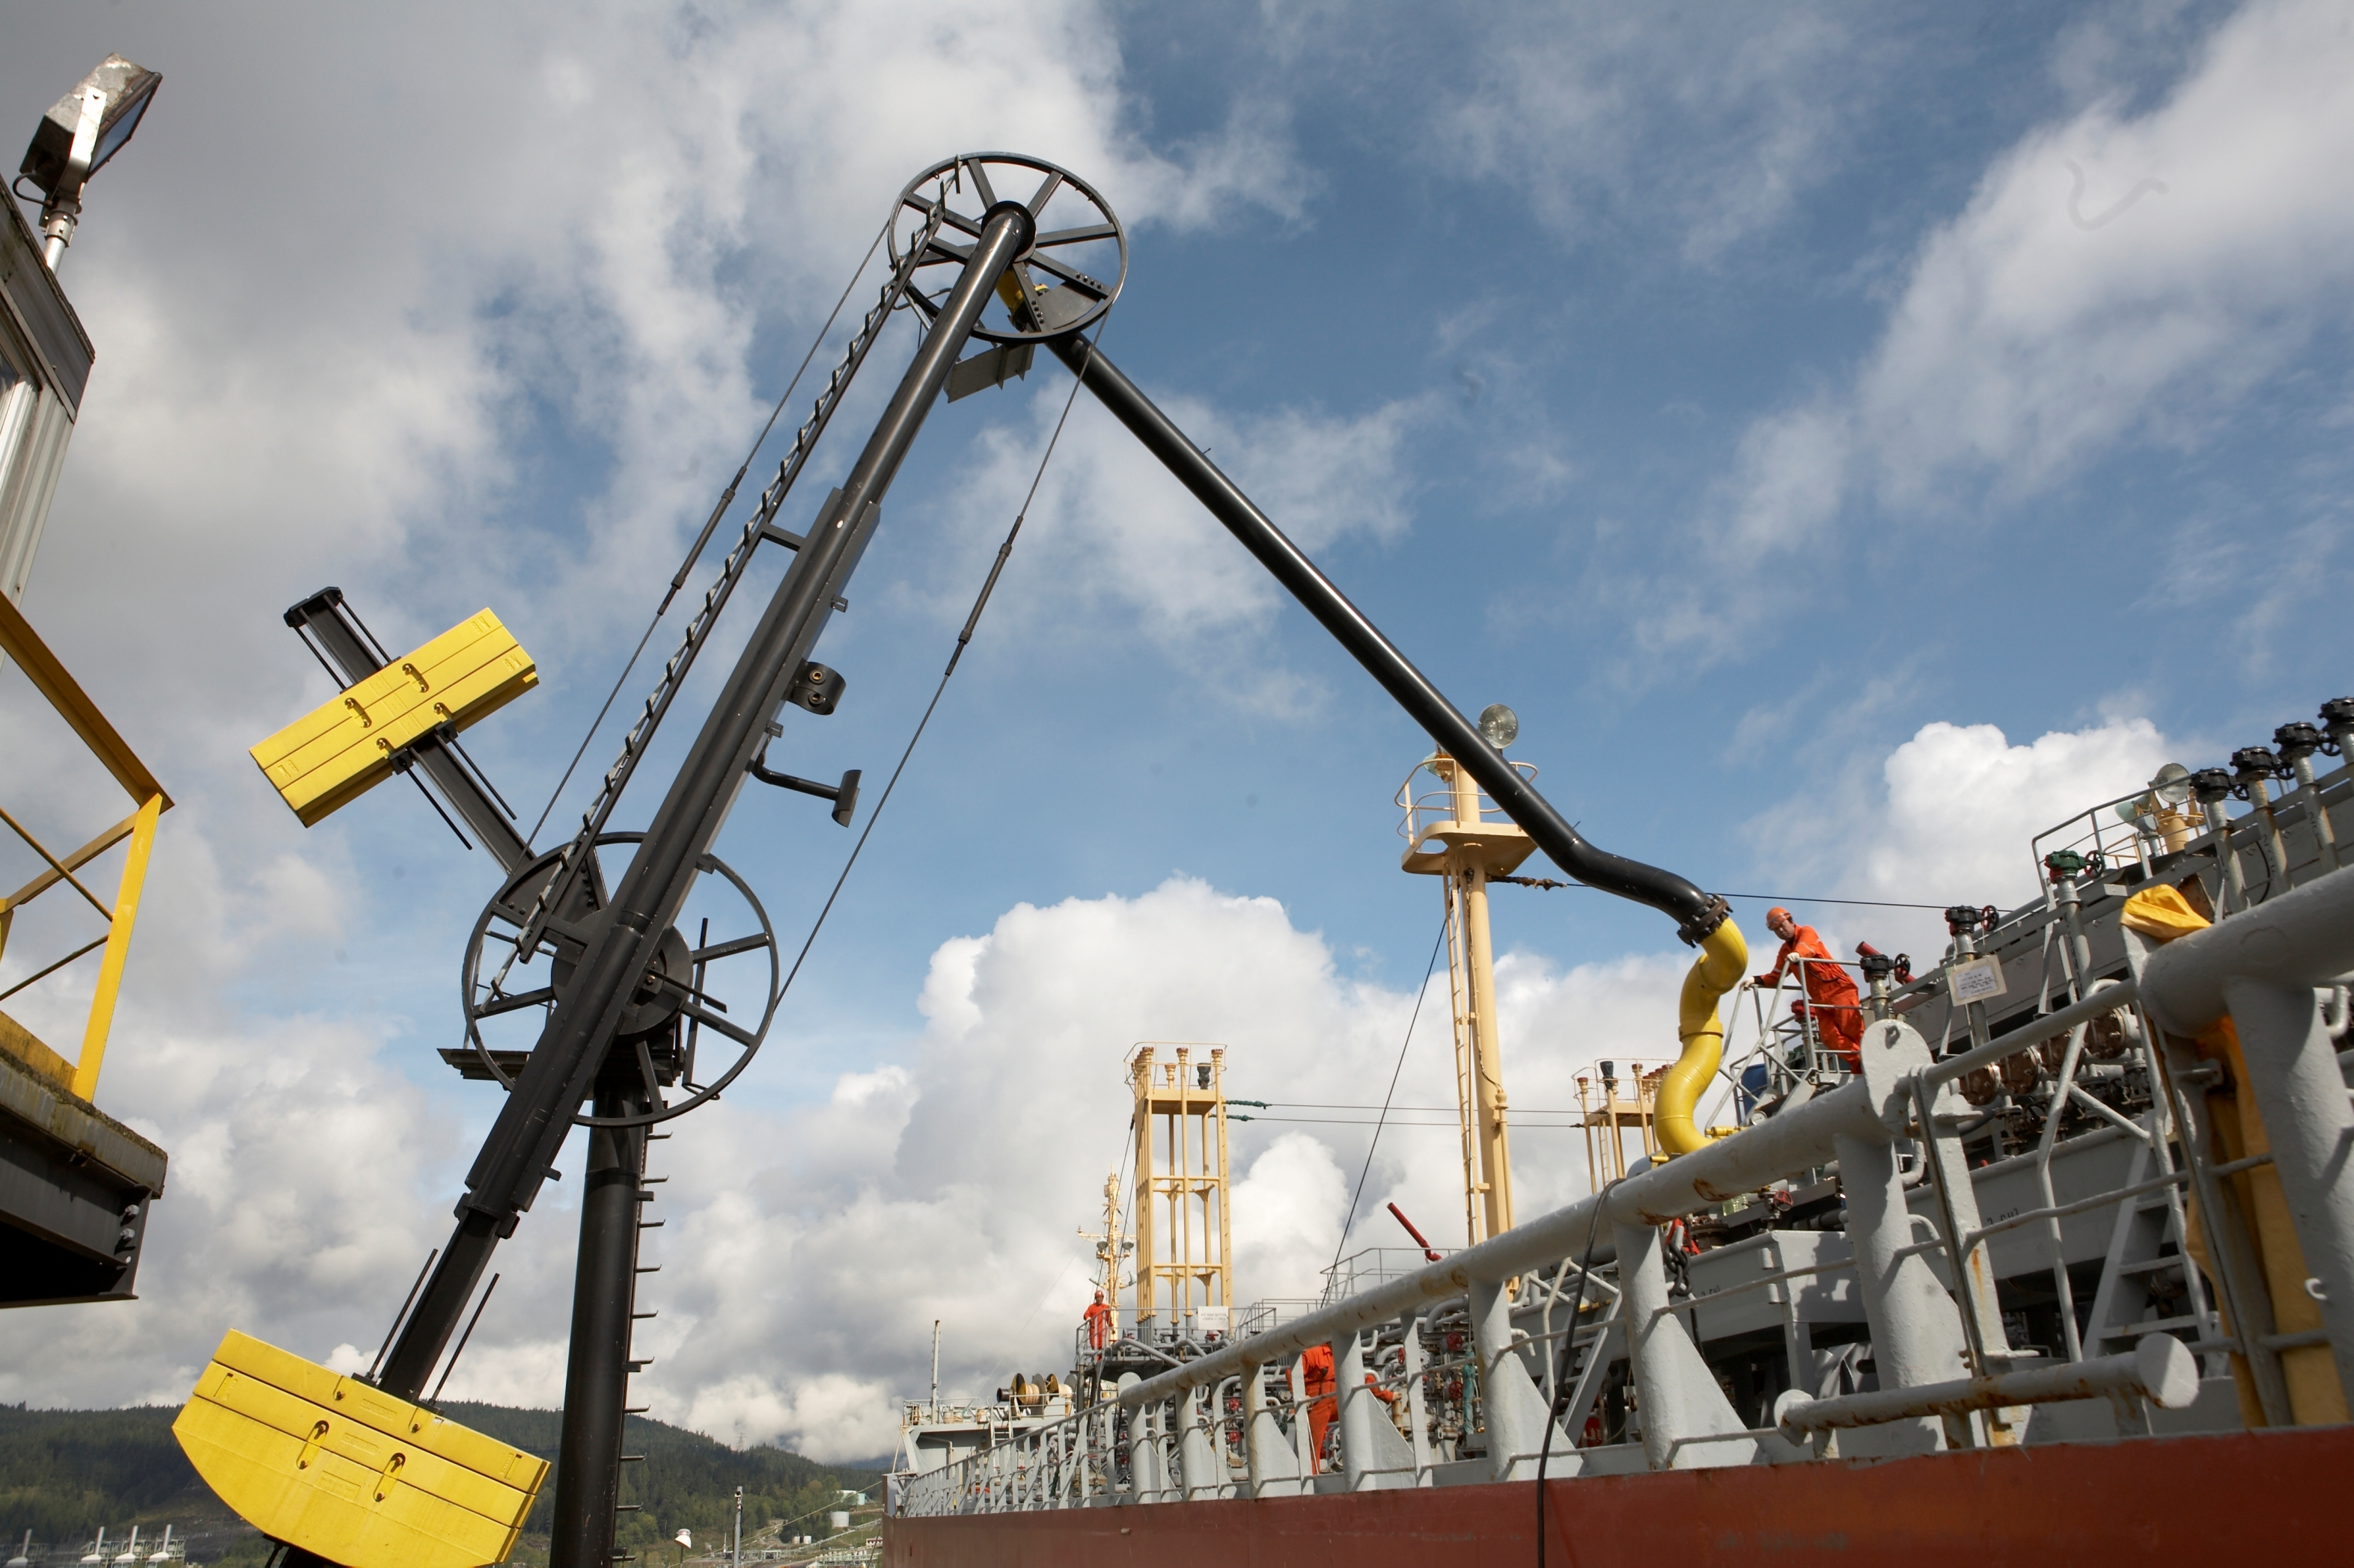
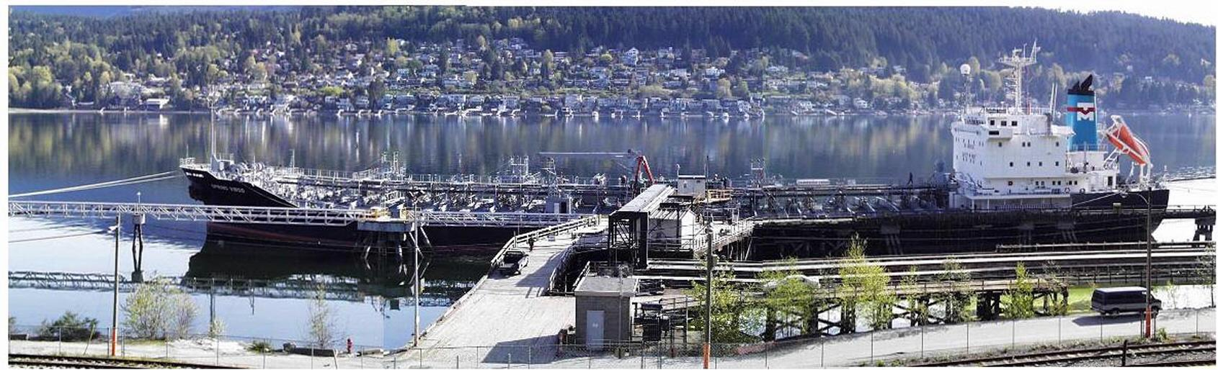
Marine Vessel Loading
Articulating and counterbalanced hard piped marine loading arm will provide connection to vessels
Small extension to Berth 1 to accommodate larger canola vessels
Marine containment boom will surround all vessels as canola is loaded

Slide 16
Environmental Protection - Marine
Hard piped loading arm will provide a secure connection to vessels while loading
PCT operator will observe loading at all times – will shut down immediately in case of an emergency
Vessel has emergency stop for PCT’s system if necessary
All valves automatically close when flow is stopped
PCT has a comprehensive Emergency Response Plan and all PCT employees are trained in emergency response
Marine containment boom will surround all vessels as canola is loaded
PCT will have spill response contractor West Coast Marine Response Corp (WCMRC) on standby to respond to a spill

Slide 17

Environmental Impacts
No air emissions from PCT’s canola operation - electrically powered pumps to transfer product
Modest increase in emissions from train locomotives and vessel traffic
Canola oil not harmful to water or soil, it is non-toxic and non-flamable
Designs will employ best handling practices and best-available control technologies

Slide 18
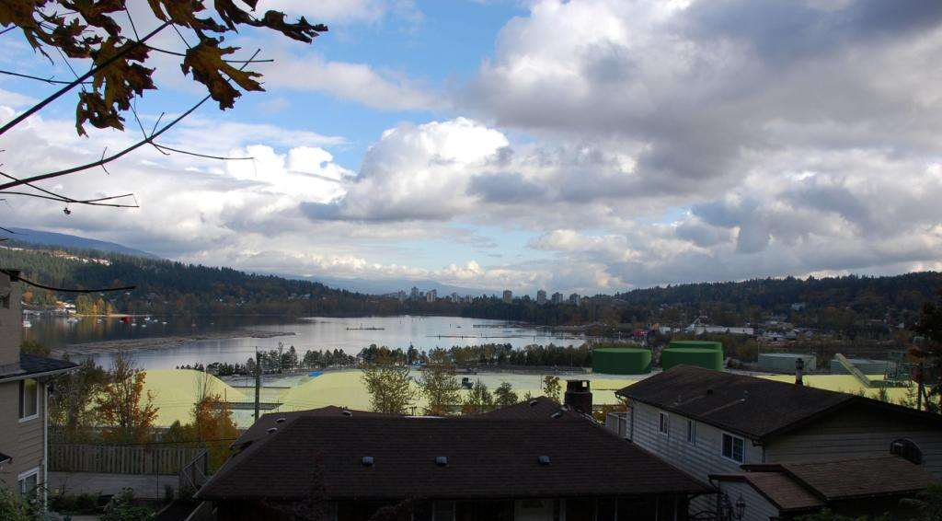
Visual Impacts

Slide 19
Canola Oil Expansion Project

Slide 20
Canola Oil Expansion Project
Glycol

Slide 21
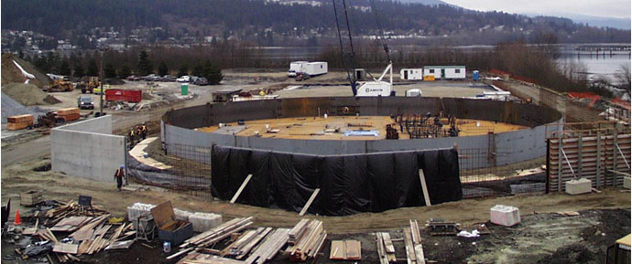
Construction Process
Dependent on issuance of permits, construction of the new canola oil facilities could start in October 2013 with completion in August 2014.
Construction issues may include additional truck traffic, noise, and short duration pile-driving (1 week)
We will distribute notices to local residents when we are aware of disruptions that may occur as we do with our other maintenance activities

Slide 22
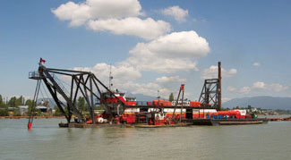
Navigation Channel Dredging
The navigation channel west of PCT has a shallow area with approximately 10 meters clearance at the lowest tide
This restricts the sailing of fully loaded vessels during that time and is very costly for PCT and vessels
Channel needs to be dredged to 13.5 meters to remove this restriction and allow vessel to transit at any time
Necessary for PCT to be able to grow its business
Permit from Port Metro Vancouver required for this project

Slide 23
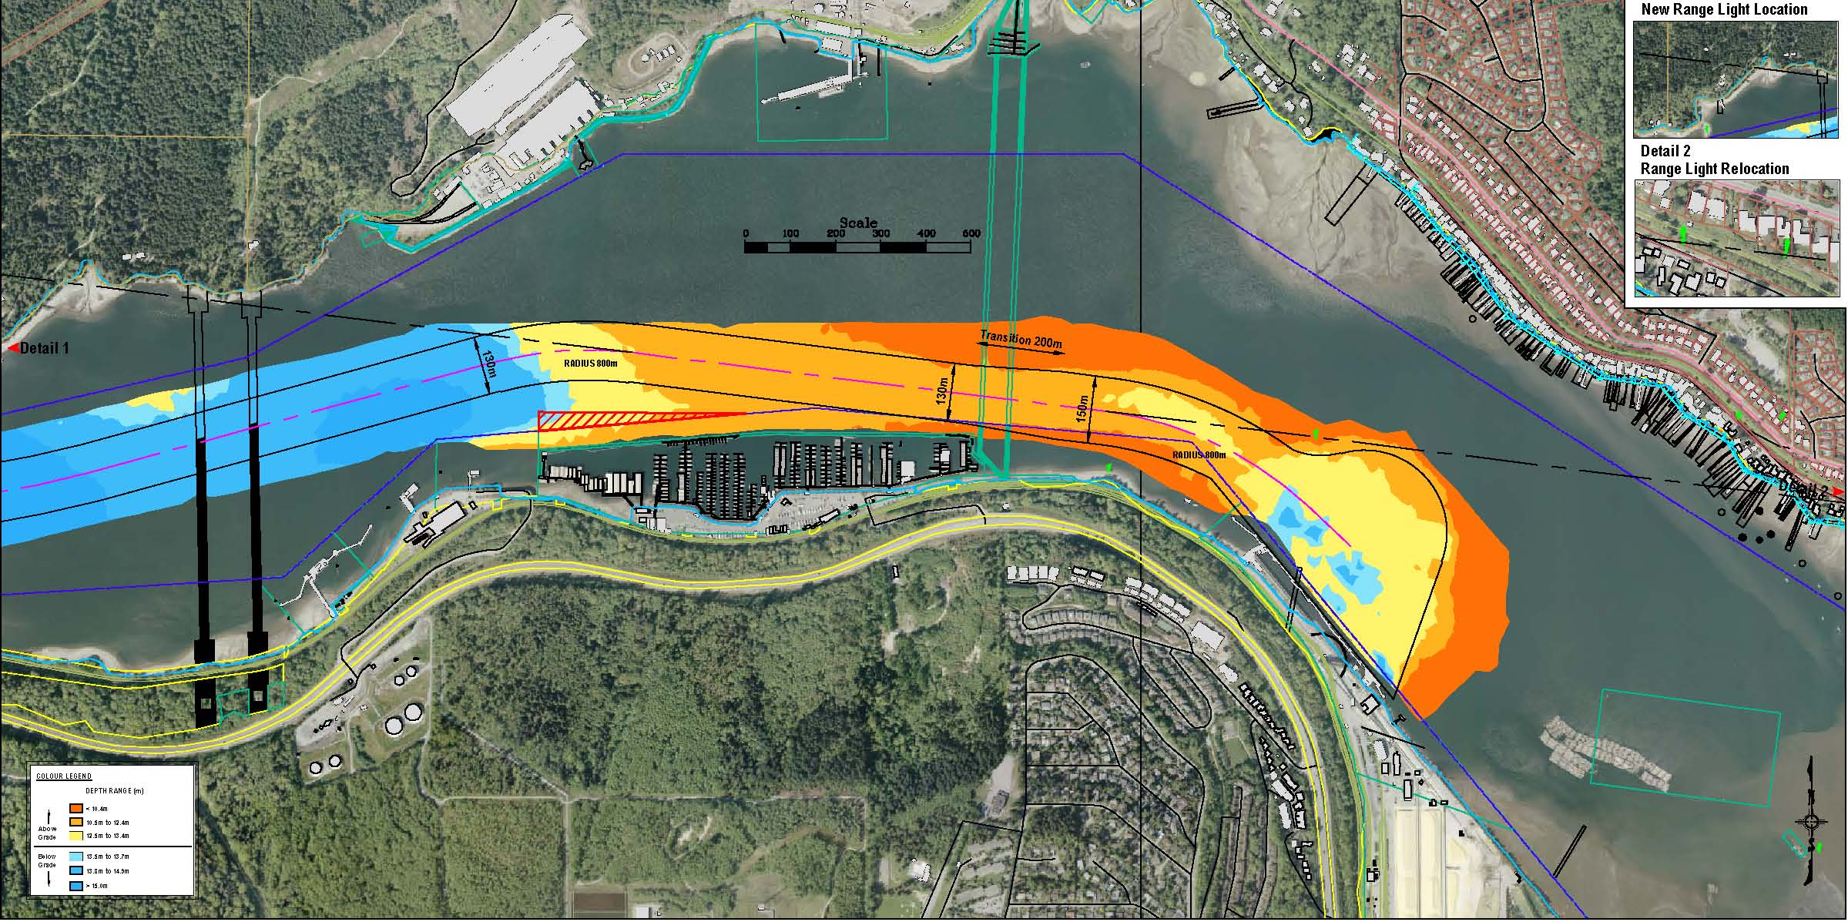
Navigation Channel Dredging
Area of channel to be dredged is indicated in red circle below

Slide 24
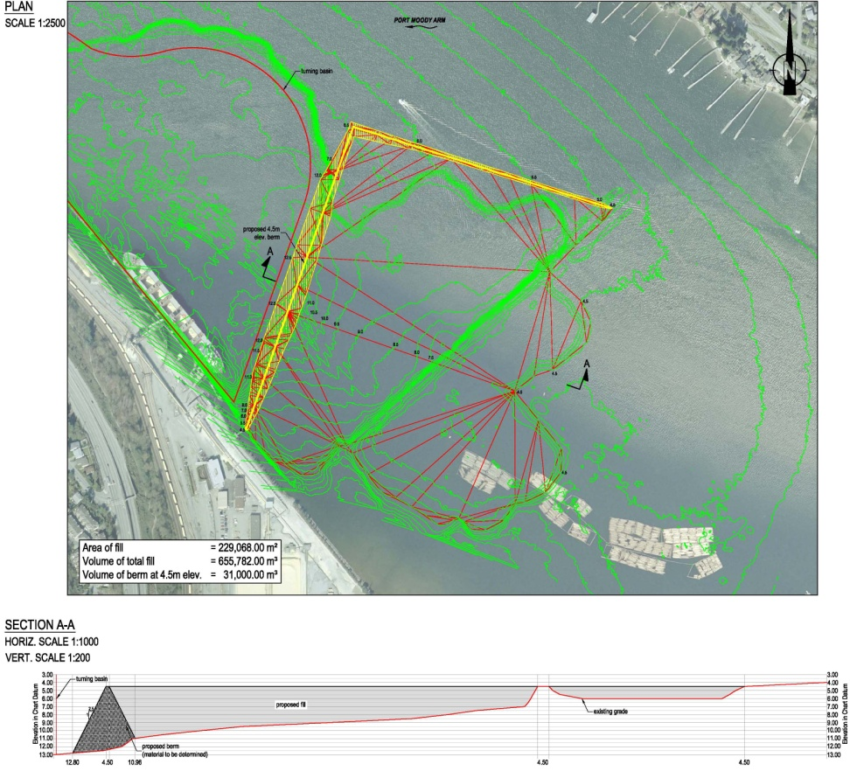
Navigation Channel Dredging
Dredged material to be relocated to a deep area of inlet near PCT
This area originally over dredged in 1960’s
Relocating sediment eliminates need for ocean dumping and provides a net environmental benefit – returns seafloor to original elevation (closer to sunlight)
Will not affect water depth for small craft

Slide 25
Navigation Channel Dredging
Anticipated project schedule (subject to permitting)
Jan to March 2014
  Prepare area that will receive the dredged material (creation of an underwater berm)
Sept to Nov 2014
  Dredge the channel and transport the material to the new location near PCT
Potential Impacts
  Some noise from the suction dredge engines when operating
  Small craft waterway will be narrower during dredging operation
  Bright lights on suction dredge when operating

Slide 26
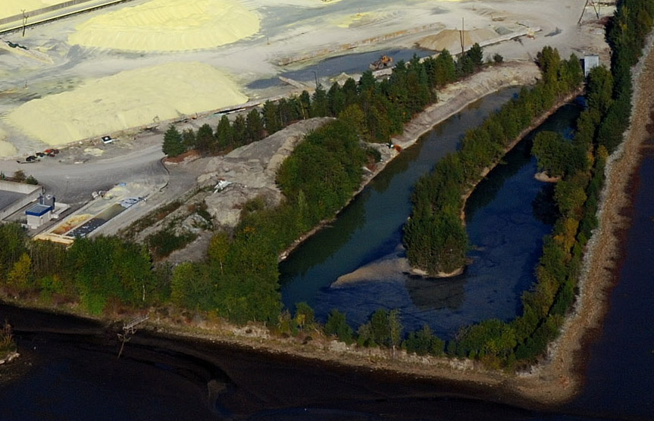
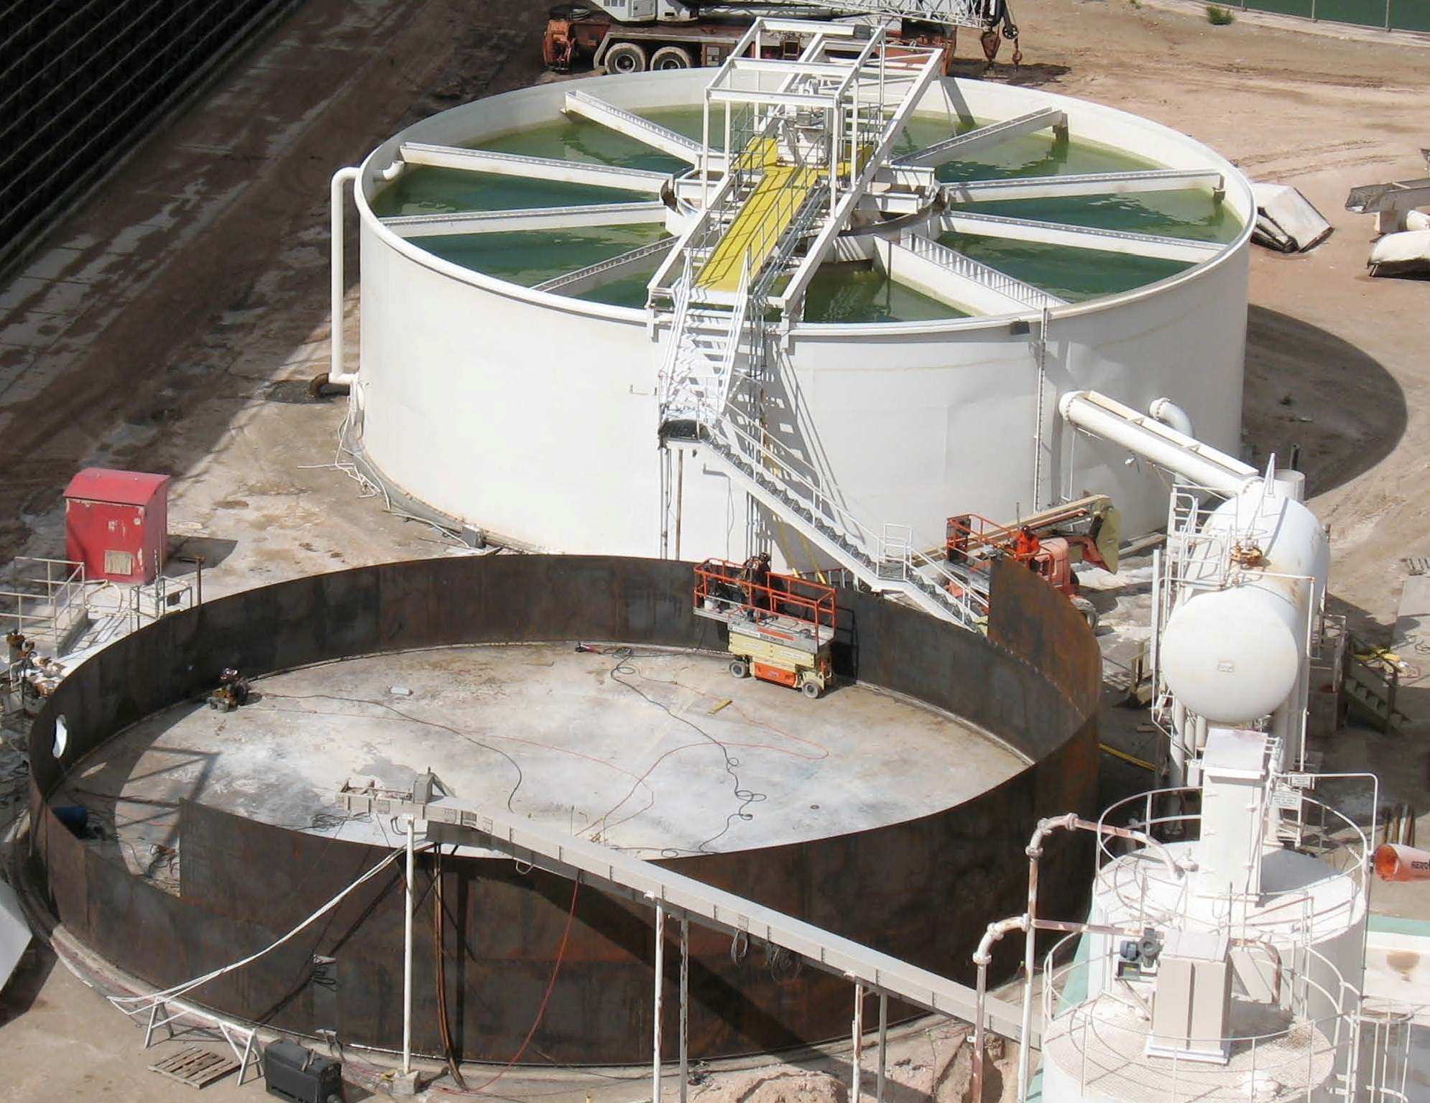
Waste Water Treatment Project
Current settling pond will be replaced with a clarifier to better handle site wastewater
All water collected on site is pumped to water treatment system prior to being recycled or discharged into the MV sewer system
Large settling pond will be eliminated (area needed for business expansion) and replaced with a clarifier similar to the photo below

Slide 27

Permitting Process - PMV
All of these projects require PCT obtain a “Project Permit” from Port Metro Vancouver (PMV)
Environmental Assessment included with Project Permit applications
  examines environmental and social impacts
  evaluates mitigation strategies if required
PMV will consult with First Nations, Province of BC, City of Port Moody and all Federal Regulators
If approved, Project Permits will contain details and conditions of approval (code & regulatory)
Project Permit applications and related documents are available for reviewing on PCT’s website under the “Growing our Business” section.

Slide 28

Permitting Process - MV
PCT has submitted an application to Metro Vancouver to amend our Air Emissions Permit to include new products to be handled
An application to amendment to Metro Vancouver’s Water Discharge Permit will outline changes to water treatment facilities
Existing limits and concentrations in both permits will remain unchanged

Slide 29
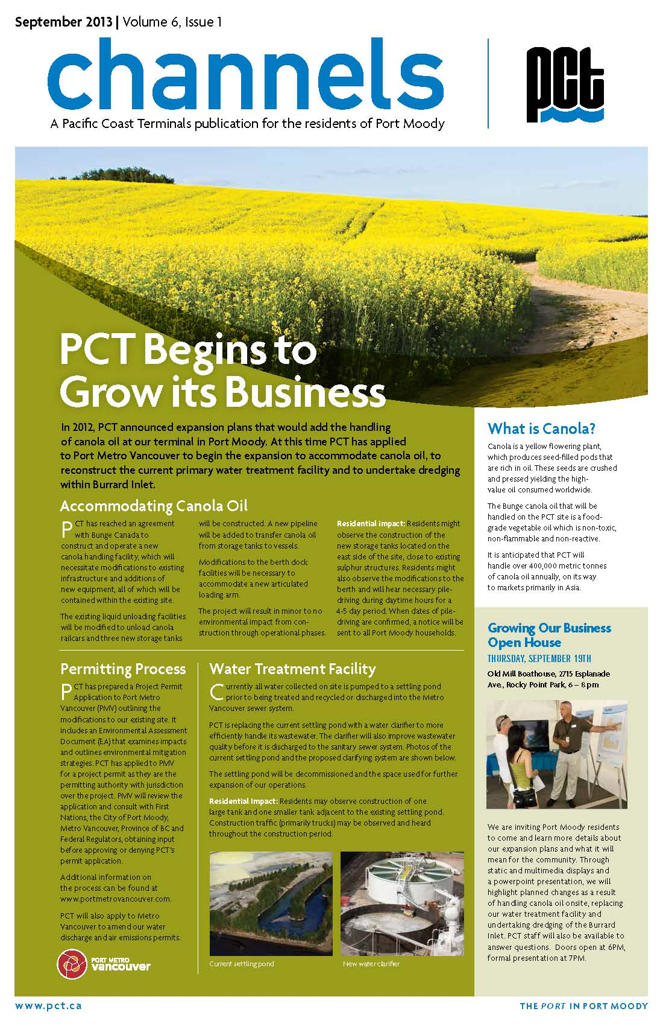
PCT’s Community Engagement
PCT is committed to maintaining our relationship with the community
Ensuring that our residents are kept informed of changes that are taking place at our site is a top priority
Detailed information will be shared by newsletter mail-outs, website, email updates, Facebook and Twitter
PCT will give presentations to community groups and organizations

Slide 30
Questions and comments?
Your feedback is welcome
Please fill out our questionnaire to let us know what you think of our project and any concerns or suggestions you may have
Please ask our staff who are here today any questions you may have
Any questions at this time?

Slide 31
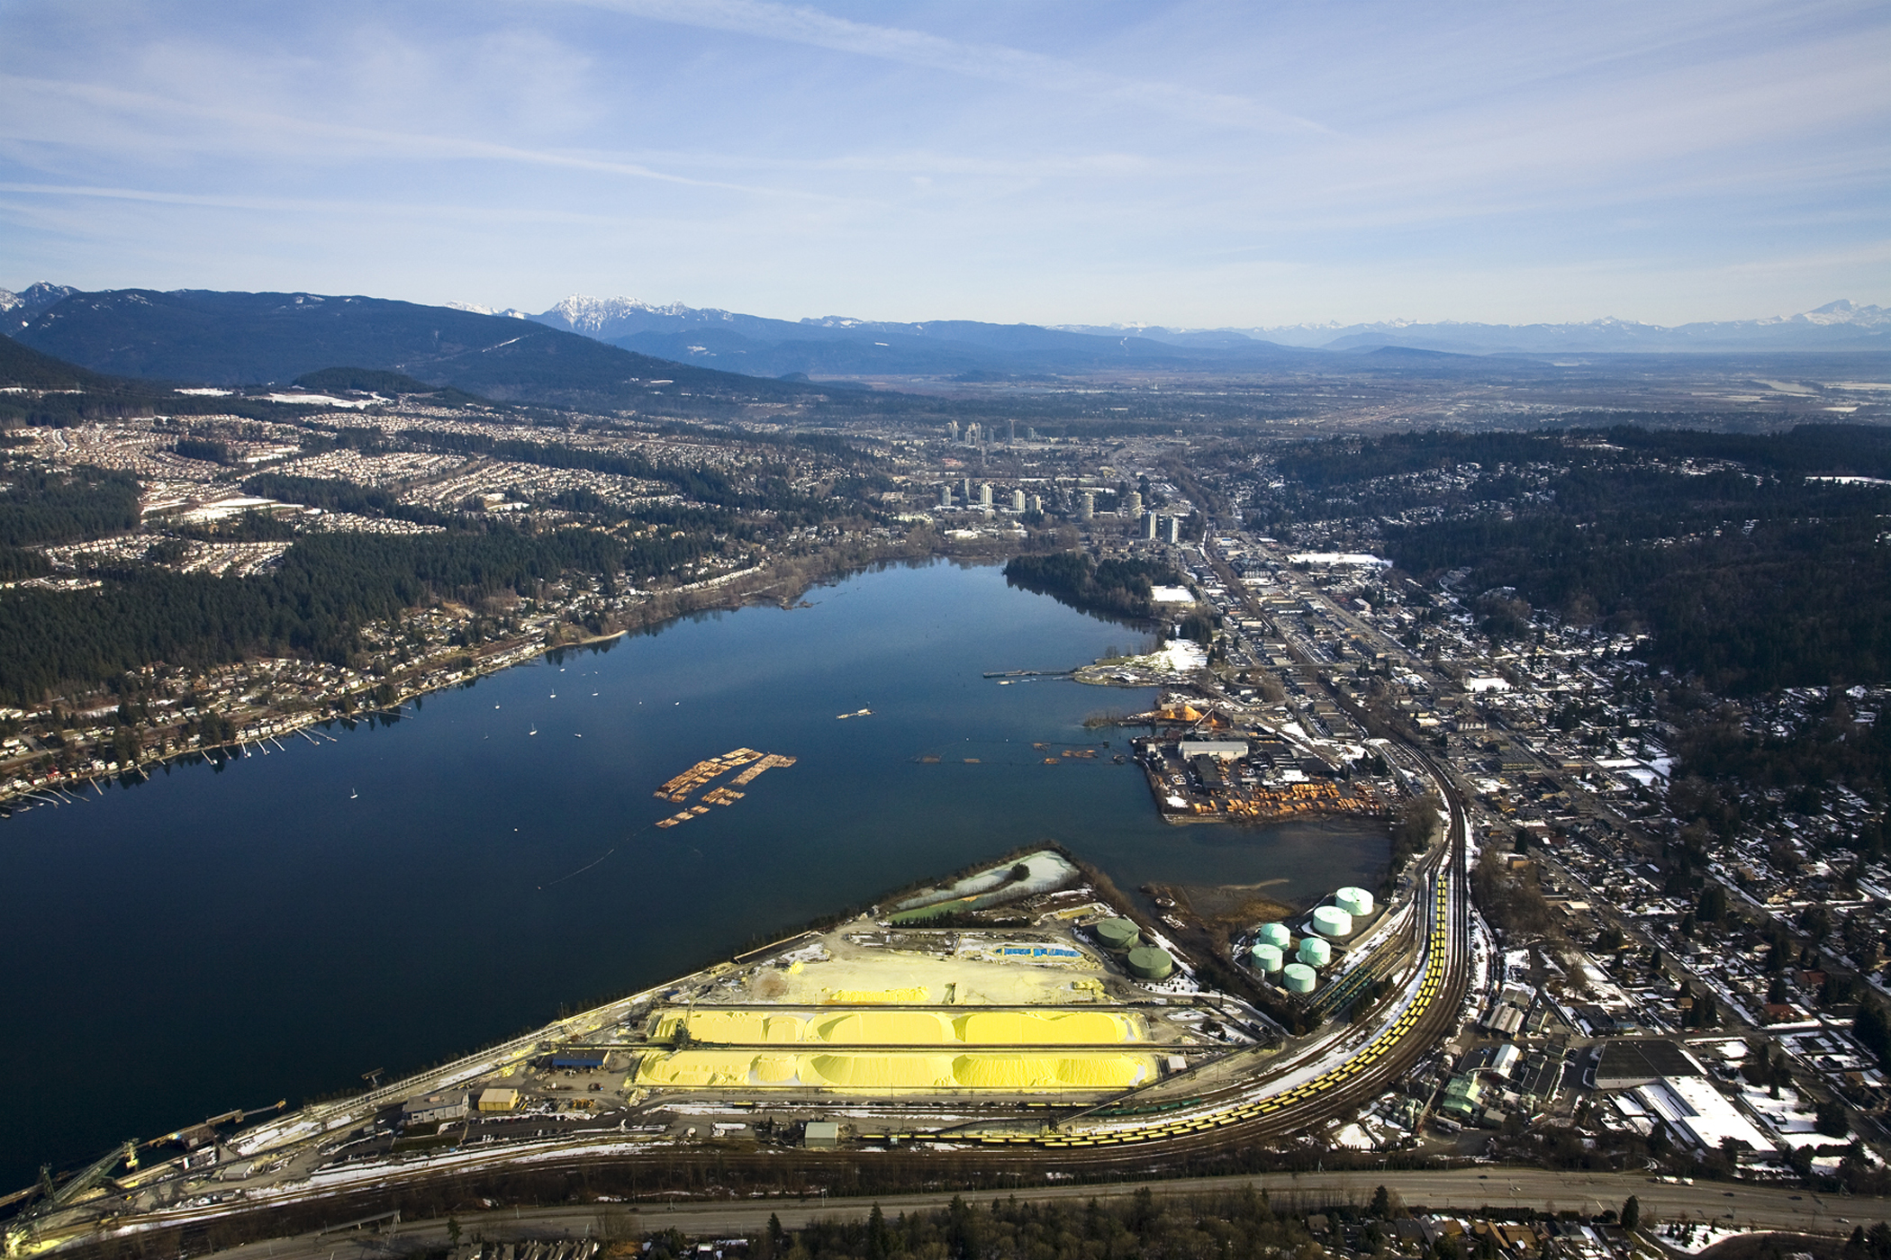
The “Port” in Port Moody

